Slide 1

Welcome to PL1101E Introduction to Psychology
Semester 1
AY 2022-2023

Slide 2

How to approach online learning
Try to treat this space as a distraction-free break for your mind – an opportunity to learn and step away from the constant distractions on your phone/laptop. In doing so, try turning your mobile phone to silent/do not disturb and put it away. See if this helps you focus and stay engaged. Try it and see how it goes! ☺ See what it’s like to be truly distraction-free when learning!

Slide 3

Today’s Lecture
Setting the stage for everything that is to come – module and beyond
Passive lecture - requires active attention
Classes will be more interactive from Week 2 onwards

Slide 4

Your reflection questions
What is the role of the student? The lecturer? The TAs?
What is the purpose of this module? What is *not* the purpose of this module?
What does a successful student do in this module? What does an unsuccessful student do in this module?
Why is the module structured the way that it is?
Why are the assessments designed the way that they are?
Why does this module matter? Why doesn’t this module matter?
What do students typically enjoy? Find challenging? Dislike?
What is higher education (HE) for, and what’s the difference between HE and formal education?
What is your lecturer’s way of educating? What are her goals/values/principles as an educator?

Slide 5
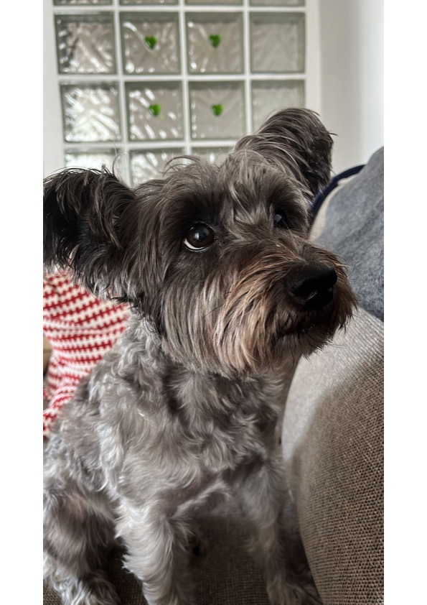
Your Prof (Dr P)
BA Psych (UNC-Greensboro)
PhD (University of Birmingham, UK)
Postdoc Fellow (UoB, NUS)
Senior Lecturer (NUS)
American/Canadian
A few of my favourite things in Singapore:
The Projector, Bengawan Solo pandan cake, dumplings, downtown, shophouses, Changi airport, the MRT

Slide 6
Research
Moral development (cognitive development)
Moral reasoning
Ai and Smart cities (ethics)
Theoretical critiques – infant morality, controversies in social sciences/academia
HIGHER EDUCATION - RESILIENCE, REFLECTIVITY, INTERDISCIPLINARITY, ETC.

Slide 7
Teaching
Introduction to Psychology (PL1101E)
Historical Controversies in Psychology (PL4242)
HSS1000 Understanding Social Complexity

Slide 8
NON-TEACHING roles
HONOURS THESIS COORDINATOR
DEPUTY UNDERGRADUATE CURRICULUM DIRECTOR
EDUCATION MENTOR – CAFÉ (CAREER ADVANCEMENT FOR FASS EDUCATORS) AND MADE IN PSYCH (MENTORING AND DEMYSTIFYING EDUCATION IN PSYCHOLOGY)
WRITING!! BOOK (ANTIDOTE TO NUDGE), HIGHER ED COMMENTARY
SOTL – REFLECTIVE EDUCATION AND RESILIENCE

Slide 9
Reading – a big list and RAG

Slide 10

What I’m currently reading

Slide 11

What is my role, the Ta' roles?
Educate
Model
Mentor
Not
Giver of high marks – No
Giver of answers – No
Friend – No
Personal tutor – No

Slide 12
What is your role?
That’s entirely up to you! I do not endorse popular notions of student-centered education/students as partners in this context/climate
What is the context/climate? Please take note of how many of you there are
Today’s student-centered education/students as partners framework is all about meeting students where they are (e.g., YouTube generation). I think meeting you where you are is harmful to your growth and development and doesn’t provide you an education worth having. Instead, I want to focus on who you might become, what you might not even think possible. Education is transformative!

Slide 13
What is your role?
I hope it might be:
To wonder, to learn, to question, to embrace uncertainty and discomfort, to take risks and engage with challenge
But it also could be:
To get an A, to do as little work as possible, to be congratulated
It might surprise you to know this, but I’m here for the former. The latter means we won’t really cross paths. If you’re currently in the latter category, that’s okay, but I won’t engage with you. I owe it to the people who are in the former group to be present for them.
The good news – if you ever want to switch from latter to former, you are always welcome.

Slide 14
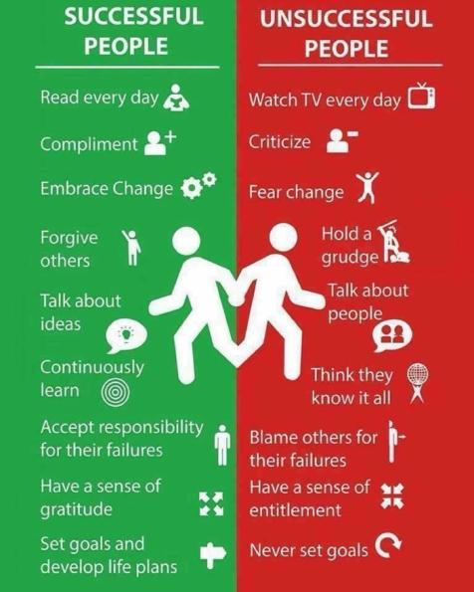

Slide 15

The module

Slide 16
What is this module, and What isn’t it?
This module is an exposure module – the aim is to:
Challenge your assumptions – why?
Get you thinking – why?
Get you curious – why?
This module is not a mastery module – why?
This module is also not for psychologizing the world, its problems or you/your friends/family members/inner circle – why?
Many people will tell you “psychology is everywhere”. In fact, that’s not strictly true. Not everything is a psychological question and not everything has a psychological answer.

Slide 17
The problem with “psychology is everywhere”
Not everything is a psychological question and not everything has a psychological answer – this module is not for psychologizing or pathologize the world
Public health and compliance – why is this not just a straightforwardly psychological question?
Depression – why is this not just a straightforwardly psychological question?

Slide 18
What is “thinking critically” or skeptically?
From 1970 to now, there are 10x the number of university graduates in SG
From 2000 to now, there are 2x the number of university graduates in SG
This seems like a straightforward win. Can you think of, and articulate, any reason why this might not just be straightforwardly good?

Slide 19
Module components
Asynchronous – recorded videos to watch outside of lecture
Synchronous – live Zoom discussion sessions (Tuesdays and Thursdays 2-4pm)
Recorded, but word of caution
In-person tutorials (see tutorial timetable on LumiNUS/Canvas)
Reading (textbook) – I will be using the 3rd edition. You may use older editions as long as you are aware that there may be some differences between the editions (why?). I don’t believe those differences are likely to create any problems for students engage with the module content
e-Library copy of textbook, also available for purchase
Research Participation (RP) – Ms Susheel Kaur

Slide 20

What are you assessed on?
Canvas quizzes (assigned in weeks 2, 4, 6, 8, 10 and 12) – open for one week
Five difficult questions (different formats) testing your ability to engage in critical thinking, not testing rote-memorization. Questions will assess your understanding of material (ability to see the bigger-picture, grasp concepts, apply understanding of concepts to a novel scenario/problem). This type of assessment is both formative and evaluative (what does that mean?)
For this reason, you can discuss the quizzes and re-attempt as many times as you wish while the quiz is open. I will only mark the final attempt and you must submit an individual quiz (even if you worked together with someone on the quiz)
Don’t expect to always score highly on the quizzes – this is by-design the challenging assessment component in the module (buffers elsewhere)

Slide 21
What are you assessed on?
Group Project – tutorials
Final Quiz – cumulative

Slide 22
Recorded material
To spotlight some basic concepts that are foundational and necessary as a basis for understanding
Complementary to the week’s topic

Slide 23
Weekly live Zoom Sessions (Tuesdays and Thursdays 2-4pm)
Focus on critical analysis of material
Go into greater depth on some topics
Highlight examples, illustrations, introduce new concepts not covered in textbook or e-lecture
Attendance is not assessed
Strongly encouraged because this is an active classroom
Slides are released after the session

Slide 24
tutorials (see tutorial timetable on LumiNUS)
Review sessions with a TA
Discussion questions created by the team with a tutor who will guide your reflection
Group Project workspace
Teaching Principle Number 3! Uncertainty to curiosity!
Entirely discussion-based, no new material
Not recorded

Slide 25
Taken together – the module has built in repetition
Read the chapter – concept introduction
Watch the recorded material
Come to class – concept revisit with in-depth exploration and critical analysis
Go to tutorial – concept revisit with reflection and curiosity plus application
A process of re-examination that may make you feel like you know less and less for sure, but means you’re going into more depth (uncertainty to curiosity)
You come for answers, but you get more out of the questions

Slide 26
Online learning
Zoom fatigue
Higher likelihood of “learning by osmosis” and multi-tasking
Online learning and a devolution into social media as education

Slide 27
support
Module content questions – Canvas (Dr P, TAs, your peers)
Module questions that fall outside of course content such as those questions concerning grading, career and study mentorship, personal issues, etc. – email Dr P
Be mindful of email etiquette – what is this? CALM. – clarity, appropriateness, length, maturity
I reply to emails at dedicated times, I’m not immediately available
There are no fixed office hours for this module, rather office hours are scheduled on an ad hoc basis. Please email me if you would like to request a consultation. Bear in mind that this is a large module, so consultations should be for matters that fall outside of general content. Your prof and the TAs are not available to provide one-on-one or small group tuition for this module outside of lectures and tutorials.

Slide 28

What I think university is for
“Life is more than a job; jobs are more than a paycheck; and a country is more than its wealth. Education is more than the acquisition of marketable skills, and you are more than your ability to contribute to your employer’s bottom line or the nation’s GDP, no matter what the rhetoric of politicians or executives would have you think. To ask what college is for is to ask what life is for, what society is for—what people are for.”
“College, after all, as those who like to denigrate it often say, is "not the real world." But that is precisely its strength. College is an opportunity to stand outside the world for a few years, between the orthodoxy of your family and the exigencies of career, and contemplate things from a distance.” - William Deresiewicz
Notes:
Instruction is the transmission of ready knowledge; education is creative.
Universities, lectures, libraries, books, museums, theatres and so forth are aids to your education that you approach in your own way.
Criticism and creativity are central to your education and personal development.
Instruction is the transmission of ready knowledge; education is creative. If I wanted to instruct you as to how to make a protein drink then I would show tell you to get a glass of water, empty the contents of the packet into the water, swirl it and drink it. I might supplement with some demonstrations of an exact operation. But if I want to educate you about protein drinks then I would ask questions, what is a protein drink, what isn’t a protein drink, and what exactly makes the critical difference? Why do we have protein drinks? Are they nutritional, do they satisfy some cultural tradition, are they sexually enhancing? How do protein drinks do what they do? Do they alter muscle metabolism, activate brain circuits associated with placebo, increase stomach acid, and so on? Instruction is universal but education is more personal; universities, lectures, libraries, books, museums, theatres and so forth are aids to your education that you approach in your own way. You don’t just passively absorb information but test it out mentally and maybe practically; criticism and creativity should be central to your education and personal development. Don’t take what I say and regurgitate it, take what I say and test it out, investigate it, delve into it and see how it fits you.

Slide 29

People who say it better
"True self-esteem means not caring whether you get an A in the first place. It means recognizing, despite all you’ve been trained to believe, that the grades you get do not define your value as a human being. It means deciding for yourself what constitutes success.”
"Here’s a rule of thumb: if you aren’t giving anything up, it isn’t moral and it isn’t courage. Stumbles, sacrifices, inner struggle, false starts and wrong turns, conflict with parents and peers—these are some of the signs of the genuine article. The way you know it’s real is if it hurts."

Slide 30
PL1101E’s Questions for the Prof Series
Many of you are just beginning your university education journey
Many of you are still considering whether you want to major in Psychology
My favorite part of university was the opportunity for guidance and mentorship from my Profs
See Canvas

